Slide 1
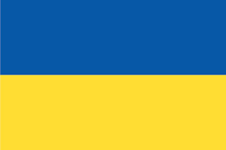

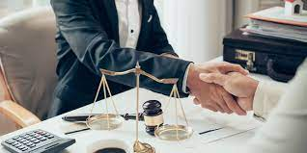
This is me: Stanislav Kornilaiev
Running and working out
Travel
Listen to music
I come from Ukraine
I’ve been living in Malta for 8 years
Junior Legal Counsel at Betsson

